Slide 1


Predictive Modeling of Electricity Access in Africa
25th May 2024

Slide 2


Our Team
Other Active Members
Iremide Oyelaja | Sakshi Hegde | Kenechkwu Aroh
Leslie Nwoniyama | Olanrewaju Stephen AMUDIPE | Bernice Akudbilla
Nnaemeka Gabriel Anyadike
Jeeval Shah
Role: Presenter 1
Adesanya. O. Michael
Role: Presenter 2
Project Lead
Name: Jeeval Shah
Assistant Project Lead
Name: Adesanya. O. Michael
Query Analyst
Name: Nwonyima Leslie

Slide 3

Problem Statement
The problem that this study addresses revolves around the persistent challenge of low electricity access in various African countries.
If this issue remains unaddressed, it could have severe consequences, impacting millions of people and impeding socio-economic development in these countries.
To effectively tackle this challenge, robust forecasting techniques like the ARIMA model need to be utilized to project electricity access levels until 2030.

Slide 4







Our Approach
 | Defined the problem
 | Data Collection & Preparation
 | EDA
 | Model Selection
 | Model Evaluation
 | Model Deployment
 | Documentation & Reporting

Slide 5

Dataset Description
Dataset
3 CSV files
Last Update: 2024-03-28
Source:
IEA, IRENA, UNSD, World Bank, WHO. 2023
https://data.worldbank.org/indicator/EG.ELC.ACCS.ZS?end=2021&start=1990&view=map
Features
Country Name, Country Code, Indicator Name, Indicator Code, 1960 – 2023, Region, IncomeGroup, Special Notes, Table Name, INDICATOR_CODE, INDCATOR_NAME, SOURCE_NOTE, SOURCE_ORGANIZATION

Slide 6

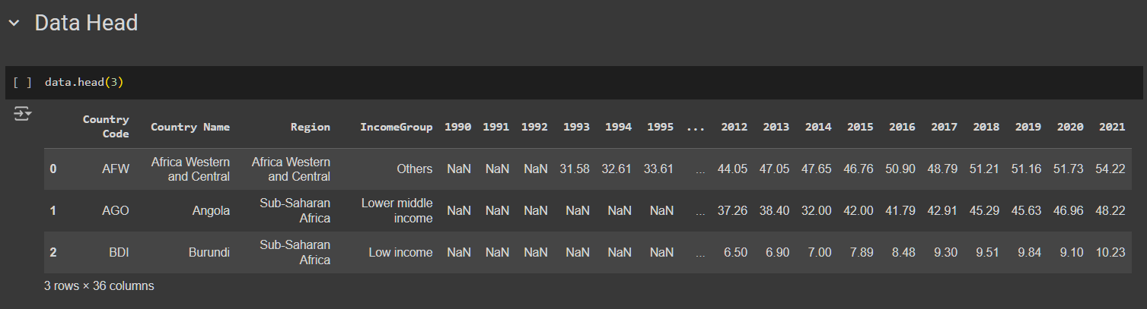
Data Wrangling
Language: Python
Features Retained:

Slide 7
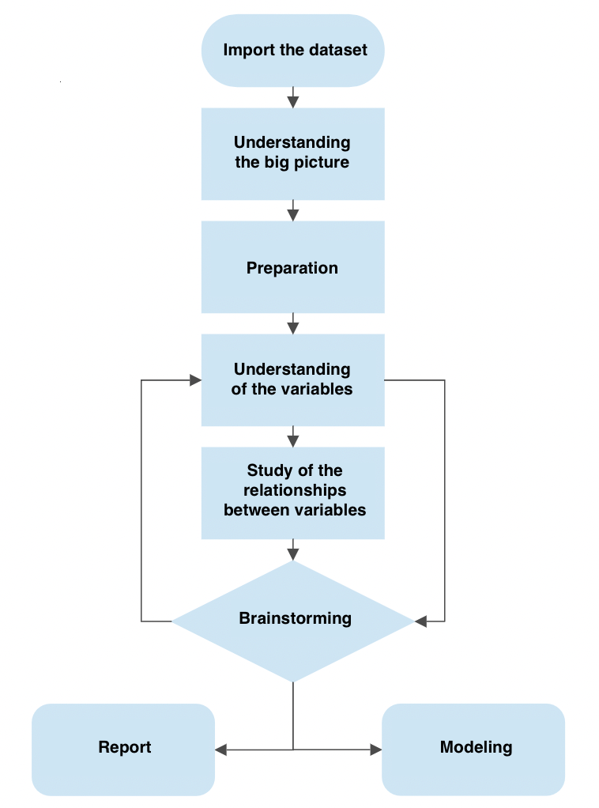
Processing & EDA
Data Shape: (57, 35)
Data Info: dtypes: float64(32), object(3)
Numerical Variables:
Index(['1990', '1991', '1992', '1993', '1994', '1995', '1996', '1997', '1998',
'1999', '2000', '2001', '2002', '2003', '2004', '2005', '2006', '2007',
'2008', '2009', '2010', '2011', '2012', '2013', '2014', '2015', '2016',
'2017', '2018', '2019', '2020', '2021'],
dtype='object')
Categorical Variables:
Index(['Country Code', 'Region', 'IncomeGroup'], dtype='object’)
Index : Country Name

Slide 8
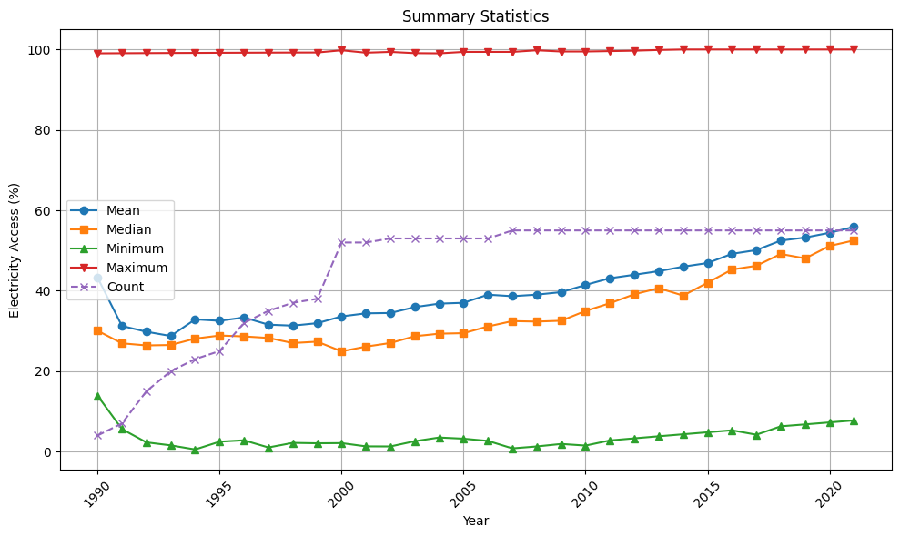
Descriptive Statistics

Slide 9
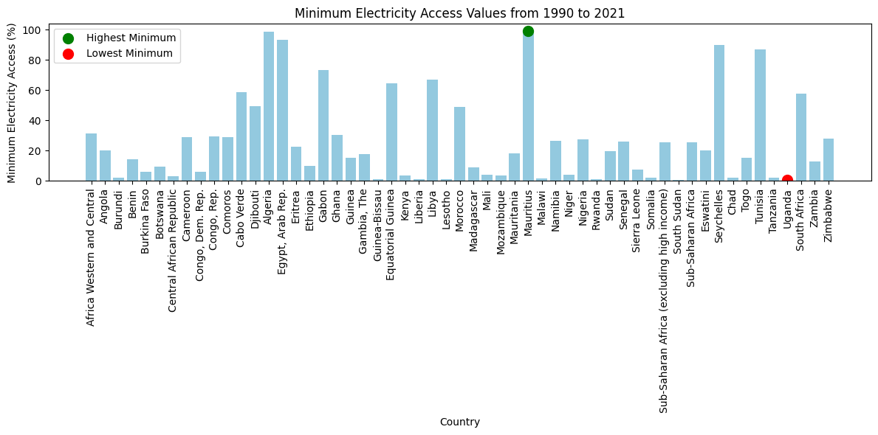
Minimum Electricity Access

Slide 10
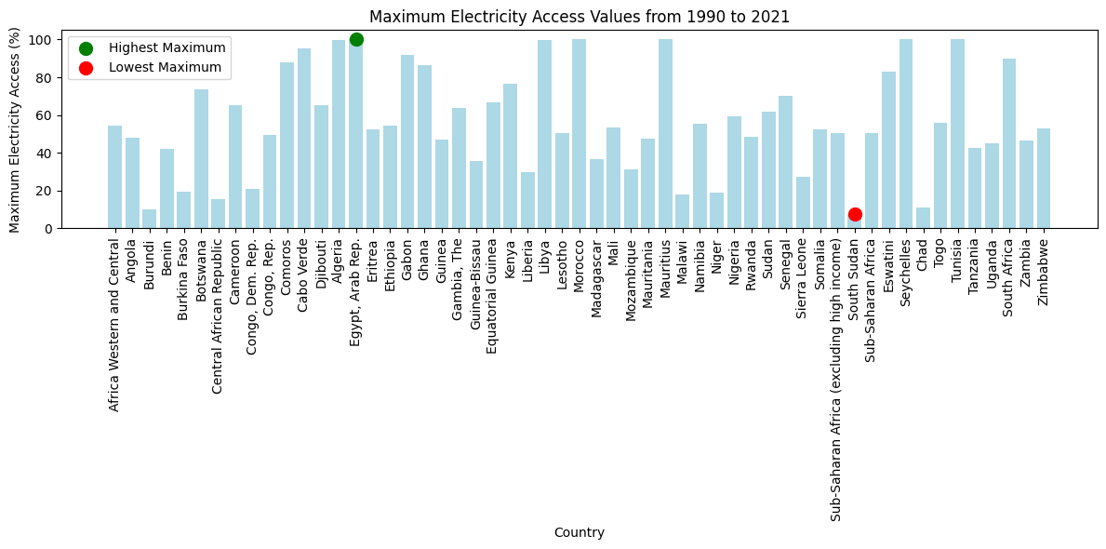
Maximum Electricity Access

Slide 11
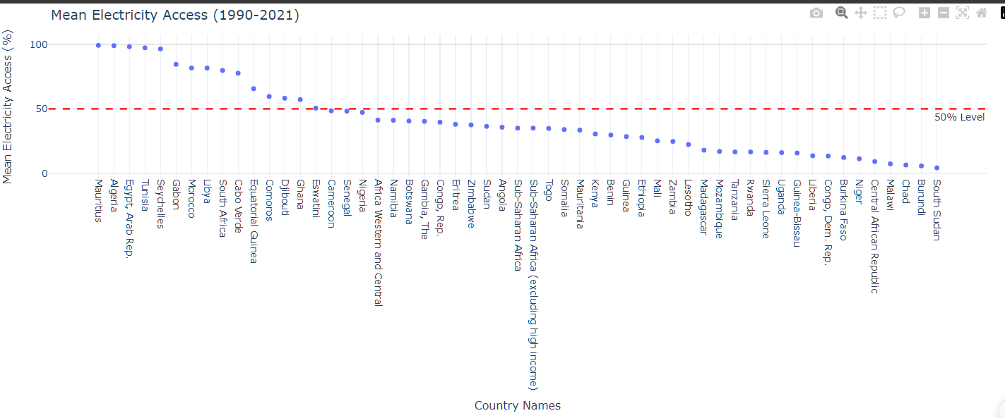
Mean Electricity Access

Slide 12
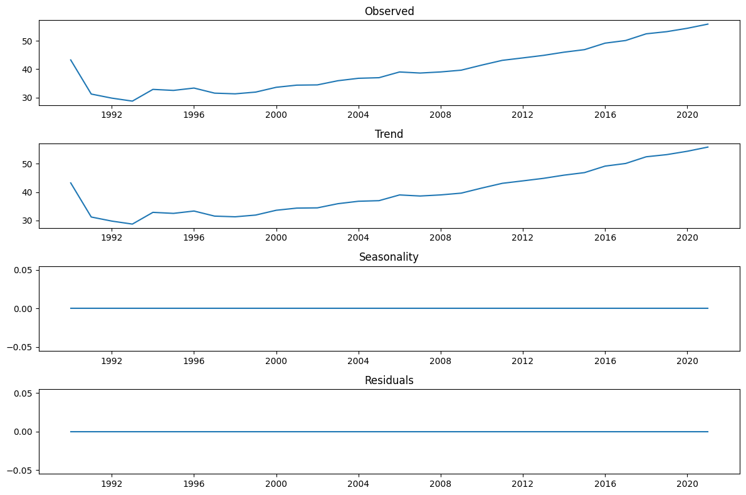
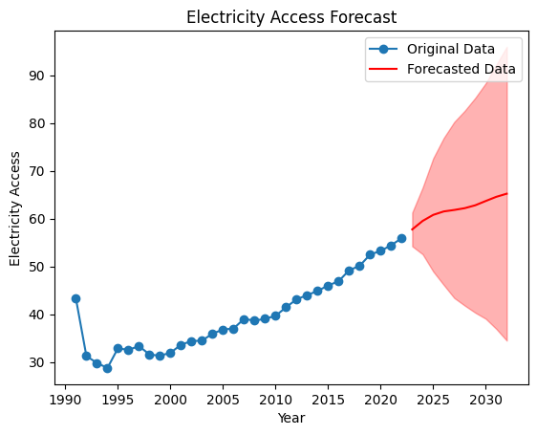
Forecast (Arima) & Trend (Time Series) Analysis

Slide 13
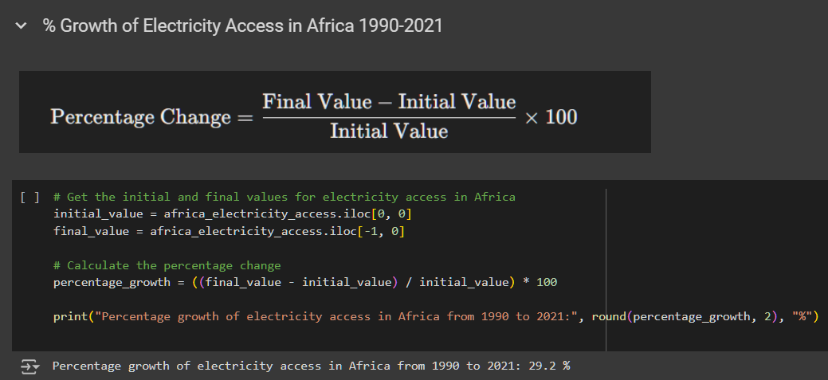

Africa @ 29.2% EA (1990 – 2021)

Slide 14
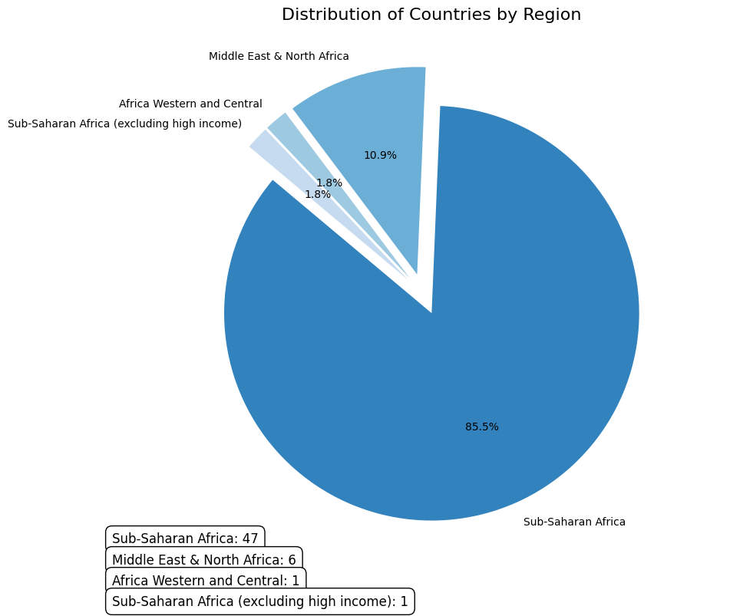
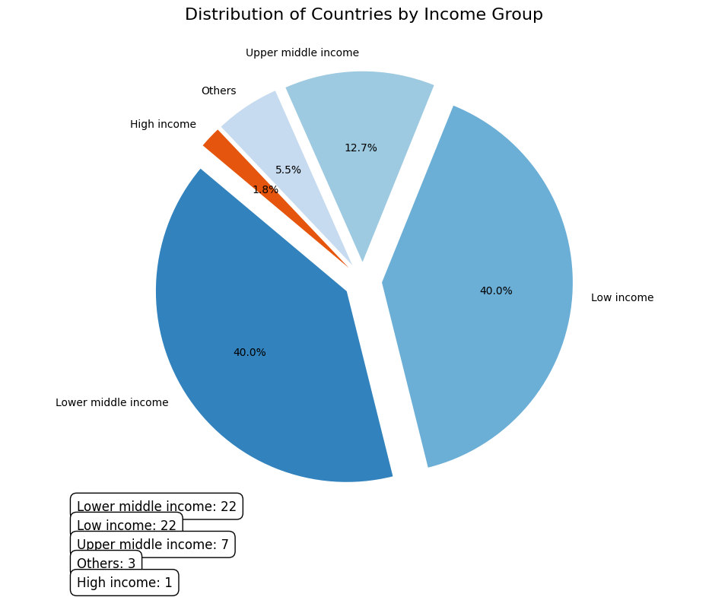
% Distribution by IncomeGroup & Region

Slide 15
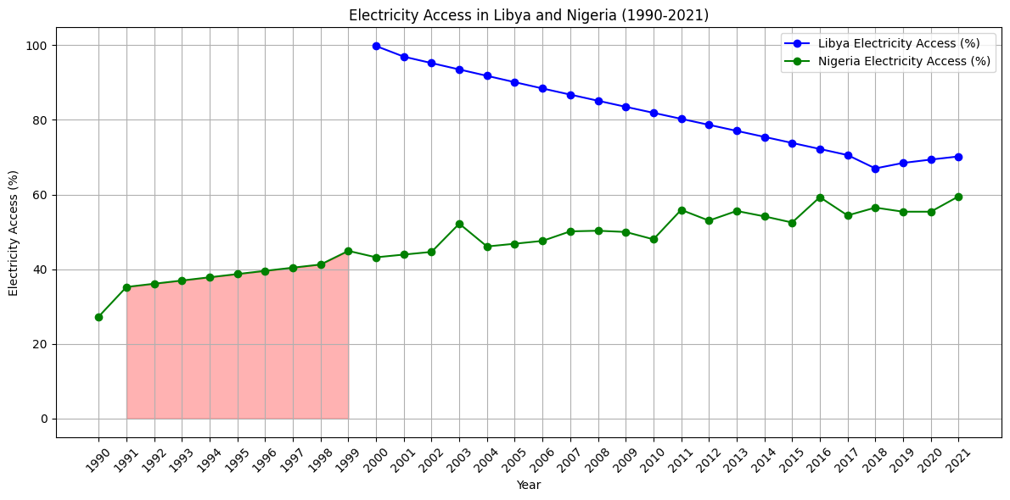
Nigeria & Libya

Slide 16
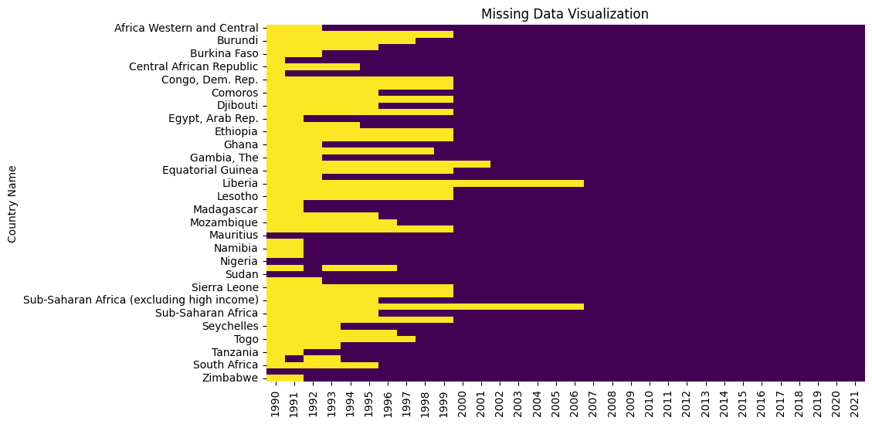
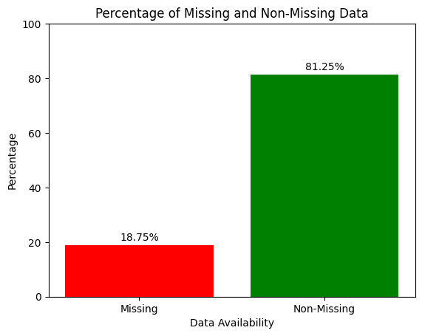
Missing Data
#Sporadic Surveys , #Initiation Year of Programs ,
#Consistent Time Series #Non-Reporting Countries
& #Non-Existent Countries

Slide 17
Model Development
Missing Data
Backfilled
LASSO
REGRESSION
Ridge
regression
Linear
regression
Lasso+ridge+linear
3

Slide 18
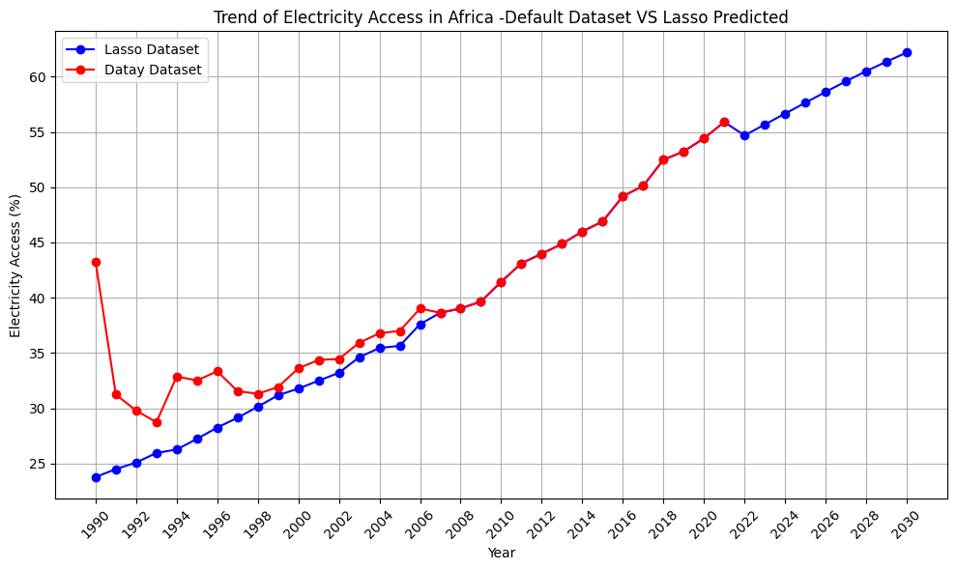
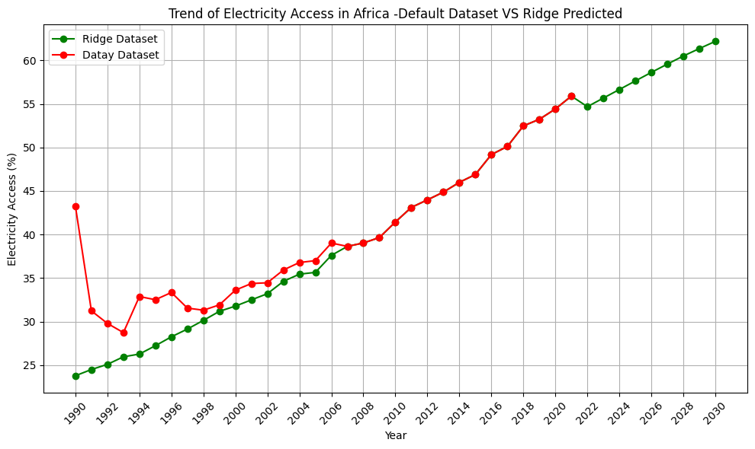
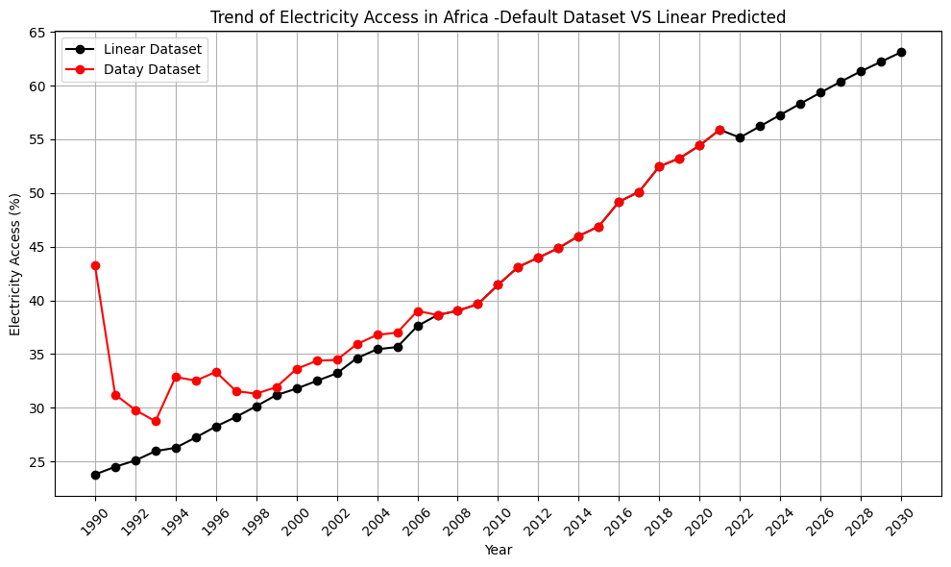
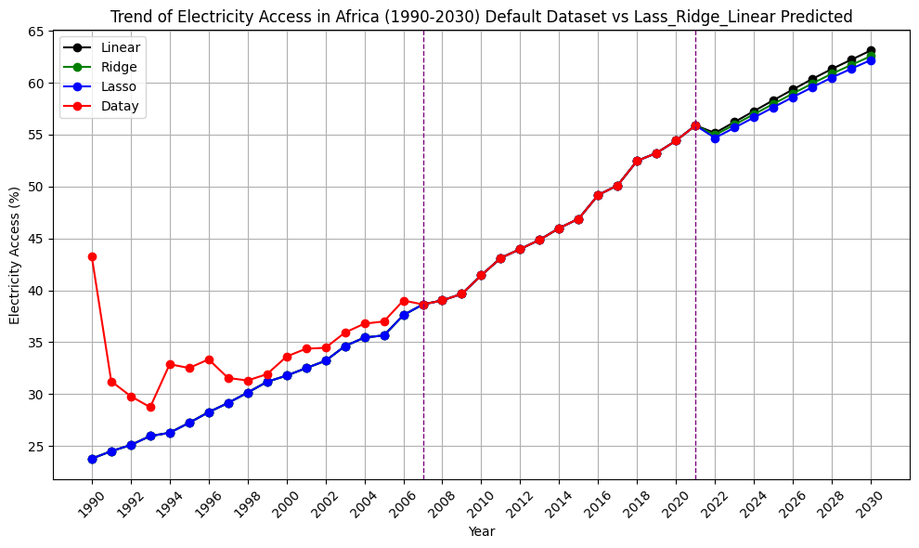

Slide 19
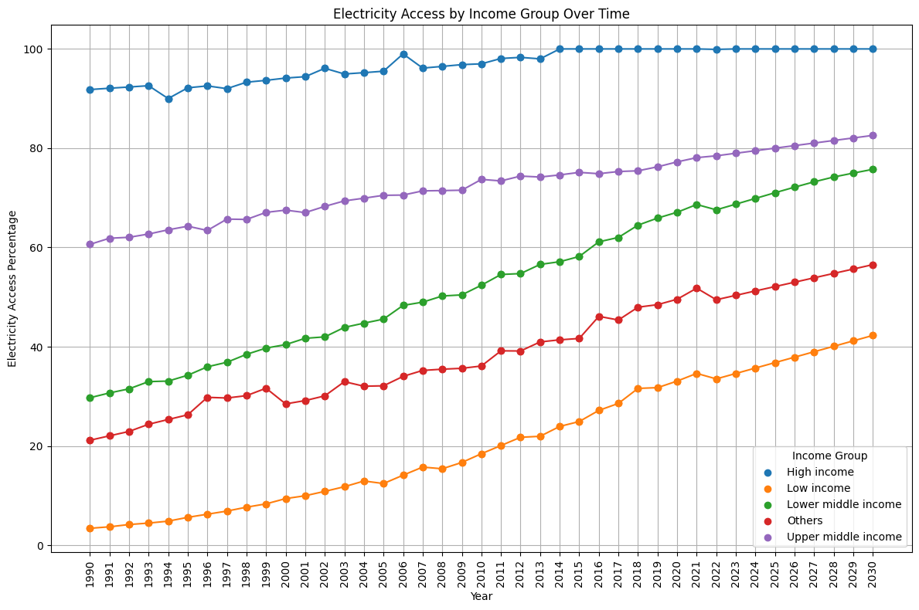
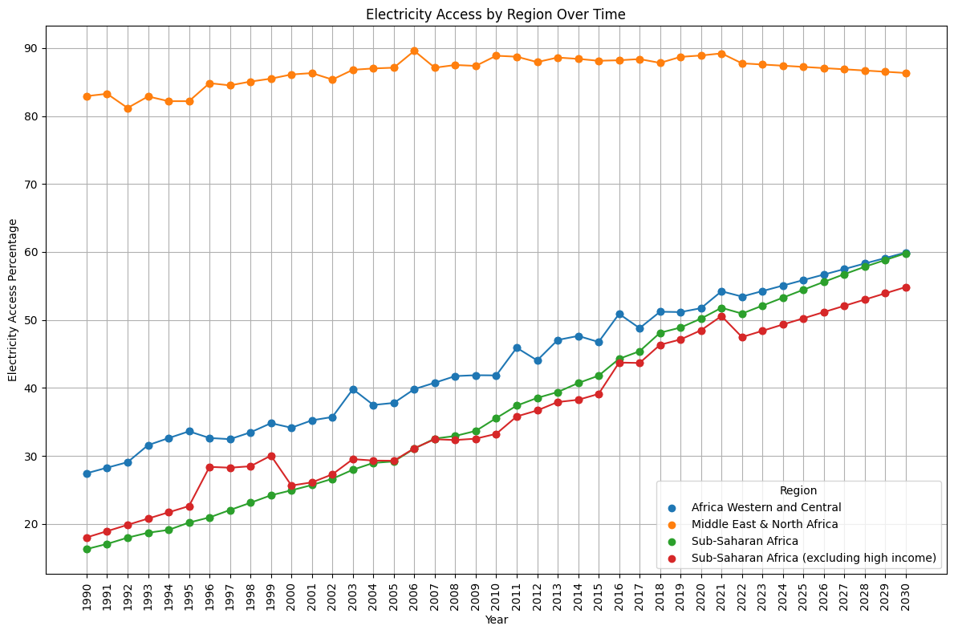
% EA By IncomeGroup & Region Overtime

Slide 20
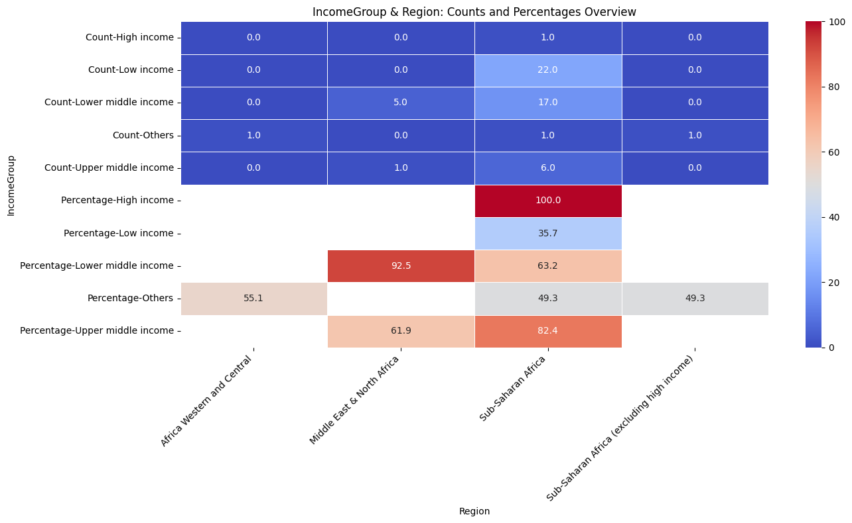
IncomeGroup & Region
1990-2030

Slide 21
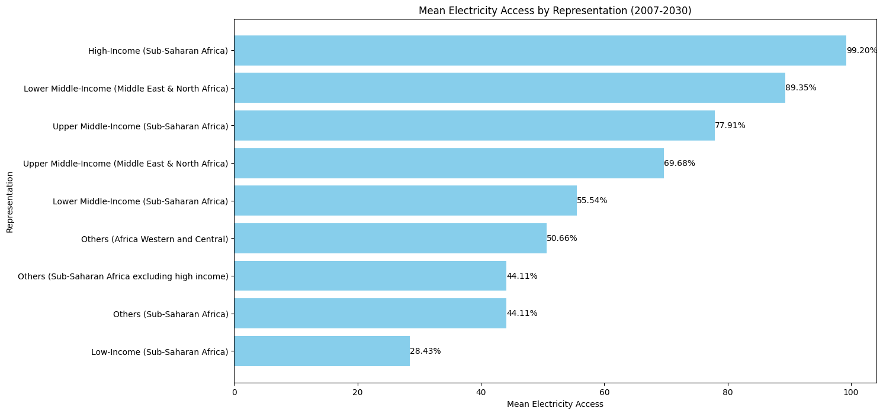
Mean EA Summary

Slide 22
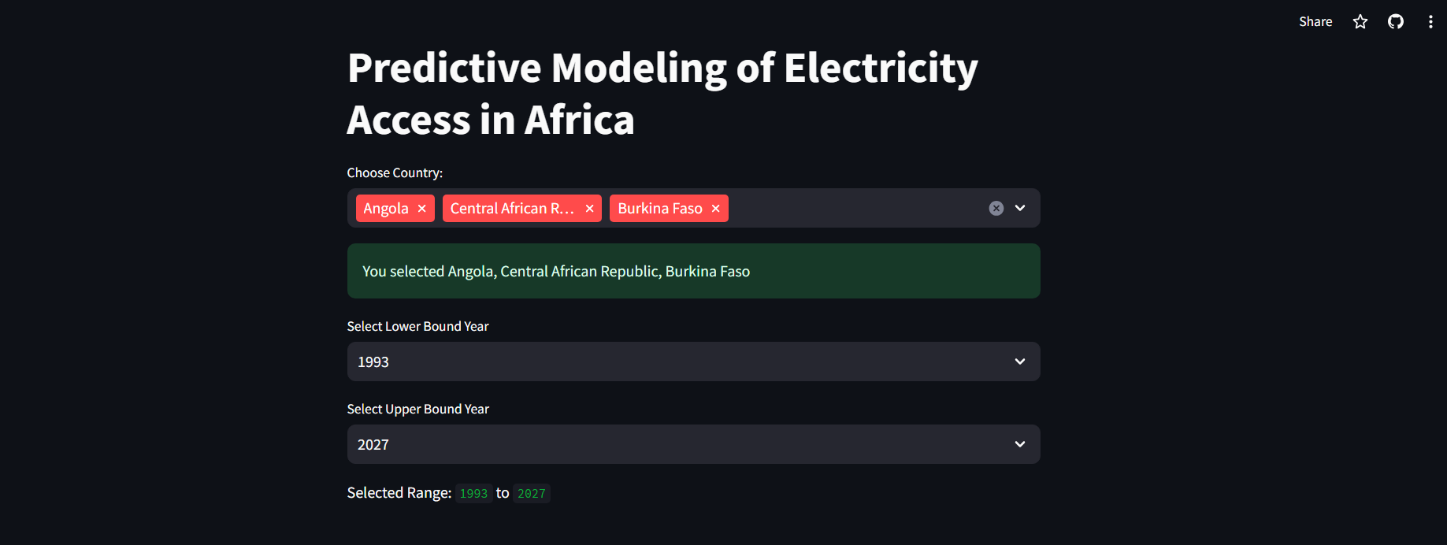
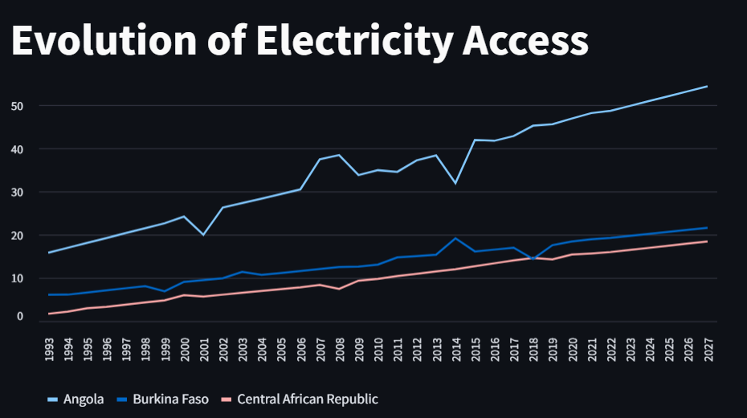
Implementation
To make our project more accessible, we have created an interactive Streamlit implementation.
https://electricityaccess.streamlit.app/

Slide 23

Wrap Up
AFRICA | COUNTRY | INCOME GROUP & REGION | Implementation
Electricity Access growth @ 29% between 1990-2021 | Zambia highest % increase @ 235.9% (1990-2021) | High income is directly proportional to high EA | A Streamlit Application for EA forecast in Africa (1990-2030)
Forecasted Electricity Access @ range 60-65% by 2030 | Libya is @ continuous decline for 2 decades (2000-2020) 100% EA to 70+% | The Margin difference between High & low income Sub-Sahara is 70.77% | Multi Country forecast Correlation
EA forecast growth from (2021-2030) is at 6.61% | South Sudan has the Poorest EA @ 7.75% (1990-2021) | The variation in Electricity Access (EA) by IncomeGroup is higher than that by Region. | All source code available on GitHub @ https://github.com/JeevalShah/ElectricityAccessVisualizationProject

Slide 24

TEAM: OPEN_aI

